Slide 1
Current strategies (customers, employees, shareholders, suppliers)
Maximize market penetration : differentiation and product placement outside of retail stores
Third place environment: create a “third place” between work and home
Maximize profitability: focus on high margin items while generating add-on sales
Store expansion
Product line: e g. offer Starbucks coffee on United Airlines flights
Horizontal integration

Slide 2
Concentric diversification : frappuccino
Conglomerate diversification: expansion into music and movies
Market development: educating the customer about specialty coffee
Value chain development: human connection gained by business ecosystem maintenance

Slide 3
Relational capital: establish close relationship with client, competitors, suppliers and employees
Cross-branding: combine two offering from separate companies to sell complementary products or services
Licensing
Supply chain distribution: effective procurement techniques

Slide 4
Governance chain for a large company: contain roles of different parties which forms the management layer
Enlightened self-interest CRS: Starbucks believes that conducting business ethically and striving to gain the long-term financial benefit to the shareholders
Globalization

Slide 5
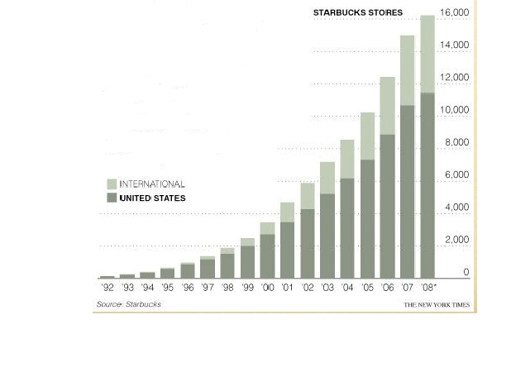
Expansion

Slide 6
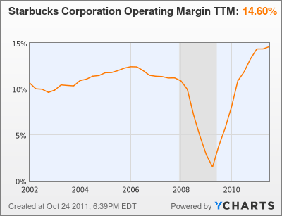
Specific Figures （focus on 2008,2009)

Slide 7
Future predictions
Changes of:
Technologies
Community
Ethical sourcing
Environment
Politics
Cultures

